Slide 1
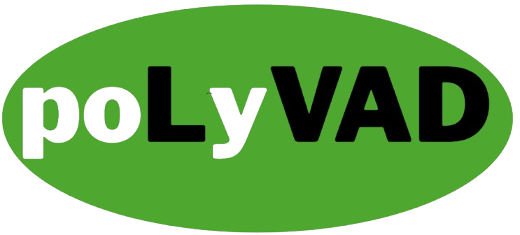







“Eliminating Driveline Complications by Eliminating the Driveline”
Omid Ghofrani
Biomedical Engineering, B.S
aoghofra@uci.edu
Brian Ngo
Biomedical Engineering, B.S
bpngo2@uci.edu
Isaac Hoyt
Biomedical Engineering, B.S
hoyti@uci.edu
Prince Mundy
Biomedical Engineering, B.S
pmundy@uci.edu
Clara Jones
Biomedical Engineering, PhD
claraej@uci.edu

Slide 2
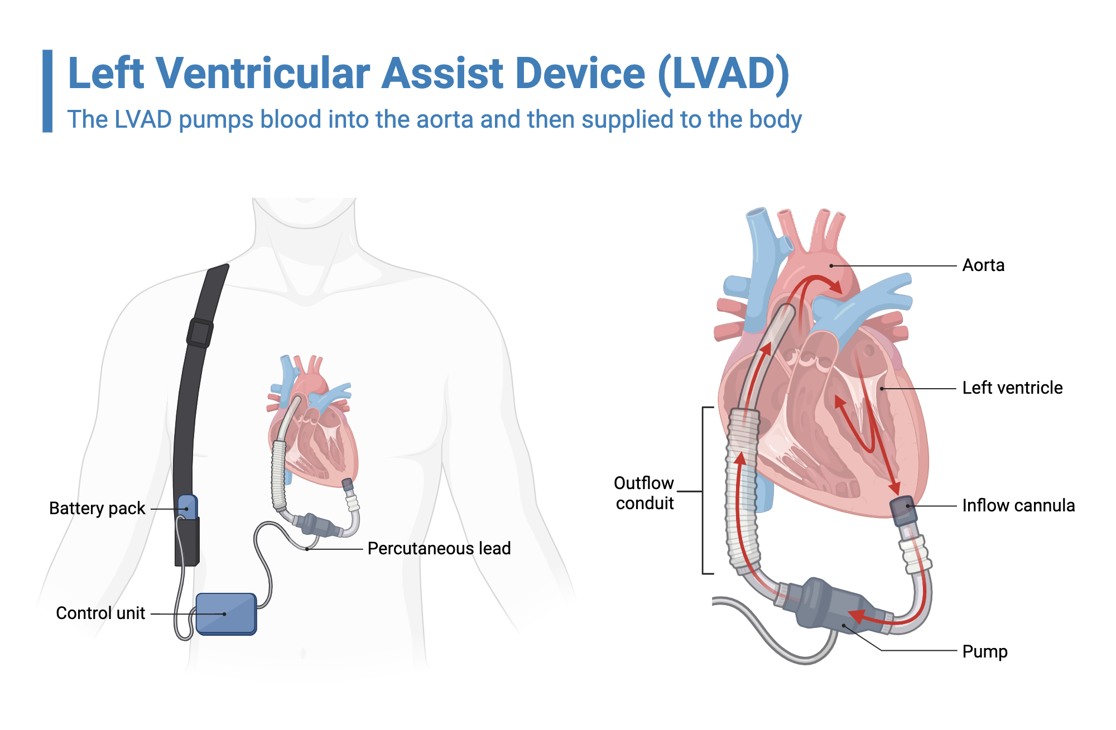
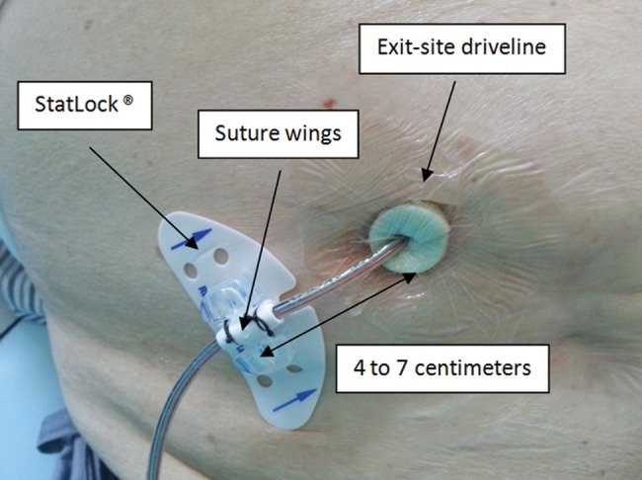
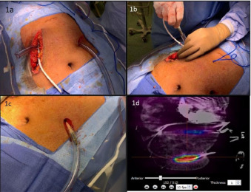
What are LVADs?

Slide 3
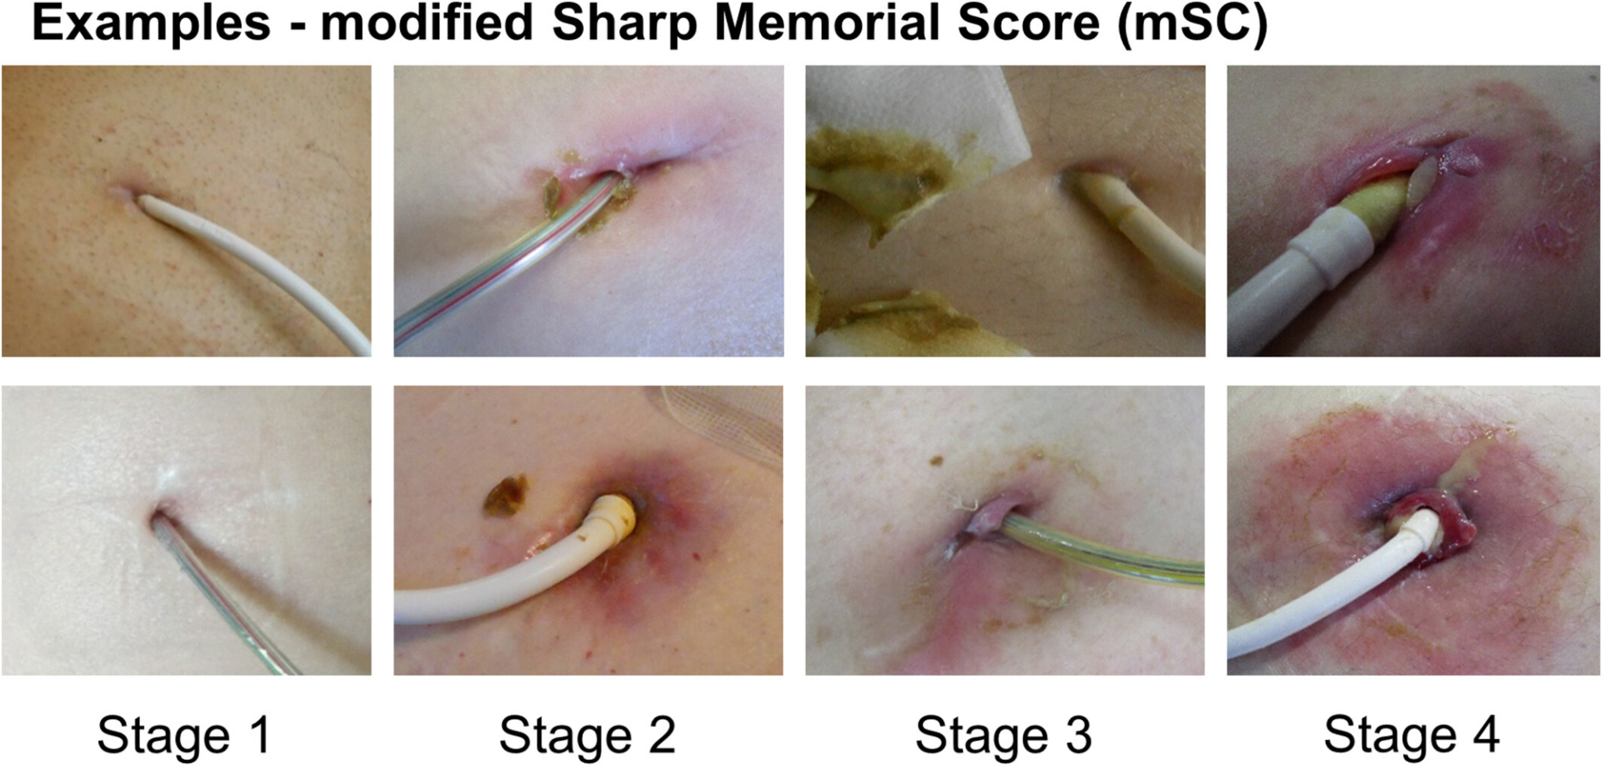

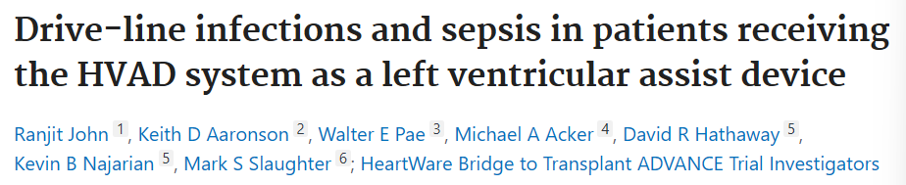
Current Problem
“Drive-line exit-site infections…
occurred in 16.9% (56 of 332) of patients.”
“Sepsis…
occurred in 17.2% (57 of 332) of patients (0.23 EPPY), and sepsis events occurred more frequently >30 days post-implant (86%, or 60 of 70 sepsis events).”

Slide 4
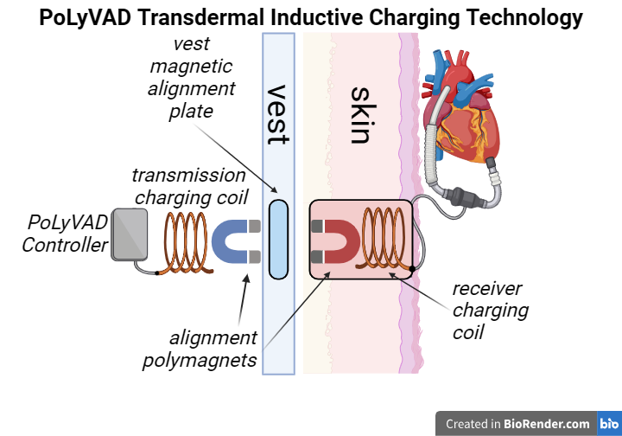
Our Proposed Solution
Polymagnetically-Coupled Inductive Charging System
Wireless Inductive Power Transfer
Fully Implantable LVAD eliminates the need for a driveline

Slide 5
Why Now?
1966
2008
2012
2018
2023
Present
The first LVAD implantation
HeartMate II approved by the FDA
TETS technology experimented with LVADs
The HeartMate3 gains FDA approval
Shift towards fully implantable LVADs
poLyVAD introduces a novel inductive charging system
Market Trends:
Advancements in Wireless Energy Transfer
Rise in Driveline Infection Costs
Growing Focus on Fully Implantable Medical Devices

Slide 6
Market Size
Value (2020): $2.7 billion
Projected Value (2025): $4.1 billion
CAGR: 8.3%
Value (2020): $5.7 billion
Projected Value (2025): $8.8 billion
CAGR: 9.1%
Global Emerging Heart Failure Device Market
(BCC Research)
US Global Emerging Heart Failure Device Market
Accounts for 20.2% of Emerging Heart Failure Device
Value (2020): $545 million
LVAD Market

Slide 7
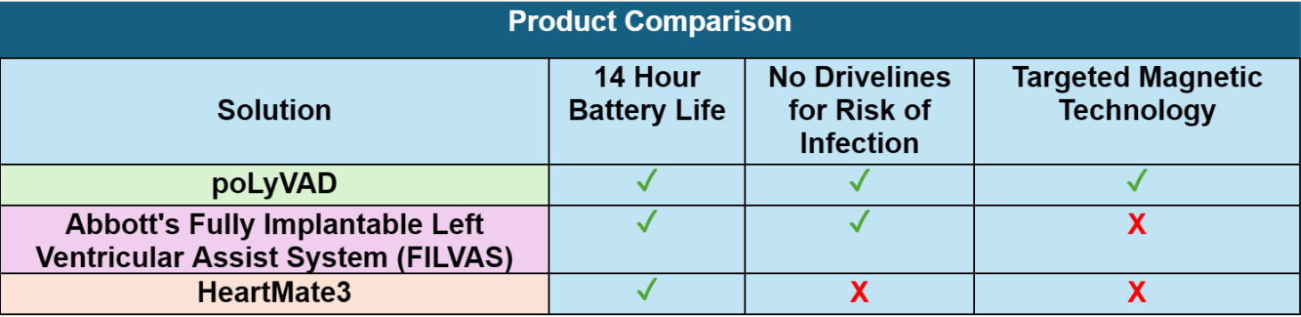
Competition
Market Landscape
Advantages
All presently available LVADs require drivelines
With HVAD (Medtronic) discontinued, Abbott’s HeartMate3 dominates the market
Small Market
Only one product stands in our way
Charging technology easily integrated with LVAD system

Slide 8
Go-to-Market
Two options for market entry:
Raise Awareness
Partnership with an existing LVAD manufacturer
Direct Sales to hospitals and healthcare providers
Showcase technology via journal publications, trade shows, and cardiology conferences
Quick market access
Lower initial costs
Limited revenue (royalties or licensing fees)
Limited control
Higher revenue potential
Full control
Longer and more involved sales cycle
Higher upfront costs

Slide 9
Financial Projections: Partnership vs Direct Sales
Securing premarket authorization from the FDA will take at least 3-5 years. Once approved, however, superior LVAD models can quickly take over the LVAD market
Direct Sales
Partnership
Royalty percentage: 3-8% of gross sales
Development and regulatory costs: $10 million
Assuming speedy market adoption, this venture would break even soon after FDA approval
Gross profit: $50k per LVAD unit
Development and regulatory costs: $60 million
Revenue and gross margins explode after FDA approval and increases in production capacity

Slide 10
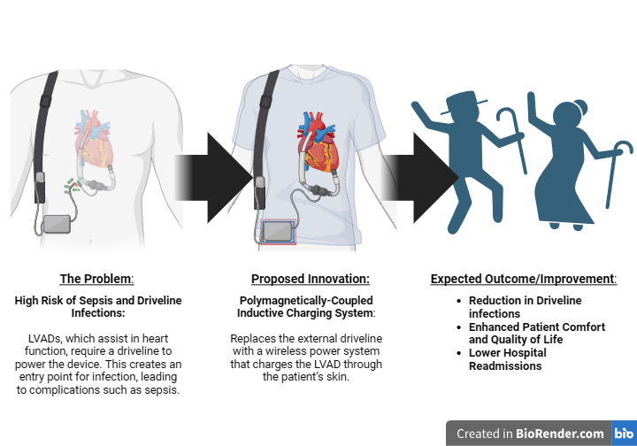

Slide 11


Slide 12
Thanks!
“Eliminating Driveline Complications by Eliminating the Driveline”
CREDITS: This Presentation template was created by Slidesgo, and includes icons by Flatcon and infographics & images by Freepik

Slide 13
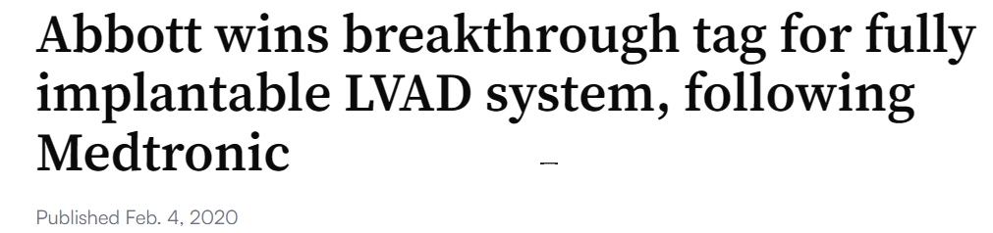
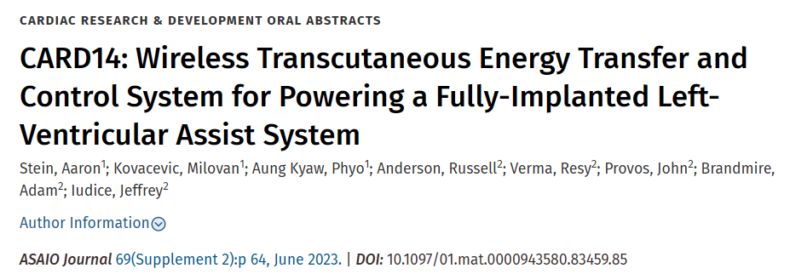
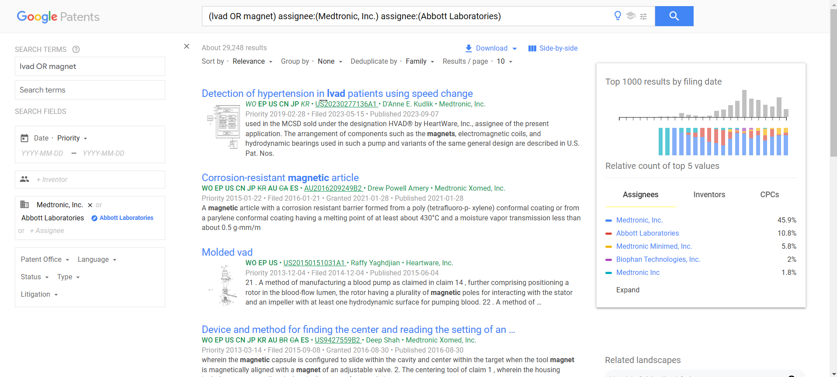
Appendix 1 - Patents
https://www.medtechdive.com/news/abbott-wins-breakthrough-tag-for-fully-implantable-lvad-system-following-m/571670/
Since our proposed innovation is a functional improvement, we will apply for a utility-type patent and this gives us a 20-year term from the effective filing date.
As our core inventive concept has already been established and is ready to present, we will take action to file a provisional/non-provisional application to the U.S. patent office.
Stein, Aaron1; Kovacevic, Milovan1; Aung Kyaw, Phyo1; Anderson, Russell2; Verma, Resy2; Provos, John2; Brandmire, Adam2; Iudice, Jeffrey2. CARD14: Wireless Transcutaneous Energy Transfer and Control System for Powering a Fully-Implanted Left-Ventricular Assist System. ASAIO Journal 69(Supplement 2):p 64, June 2023. | DOI: 10.1097/01.mat.0000943580.83459.85
Notes:
Two medical device companies, Abbott and Medtronic, are currently in the process of developing fully implantable LVAD systems [3] but lack polymagnet technology [2]

Slide 14
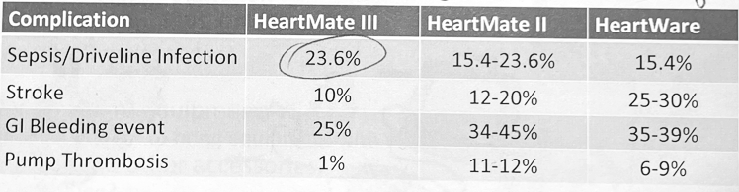
Appendix 2 - Supporting Infection Info
Figure 2. Chance of each complication happening with each successive device within a 2-3 year implantation.

Slide 15
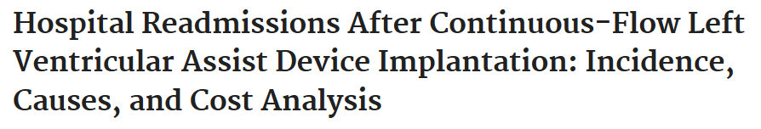
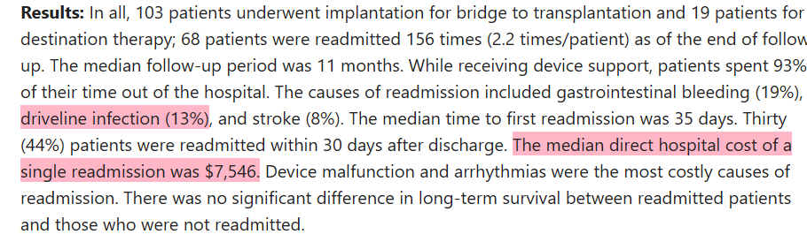
Appendix 3 - Market Analysis (LVAD Infections)
Akhter SA, Badami A, Murray M, Kohmoto T, Lozonschi L, Osaki S, Lushaj EB. Hospital Readmissions After Continuous-Flow Left Ventricular Assist Device Implantation: Incidence, Causes, and Cost Analysis. Ann Thorac Surg. 2015 Sep;100(3):884-9. doi: 10.1016/j.athoracsur.2015.03.010. Epub 2015 Jun 19. PMID: 26095106.

